Slide 1
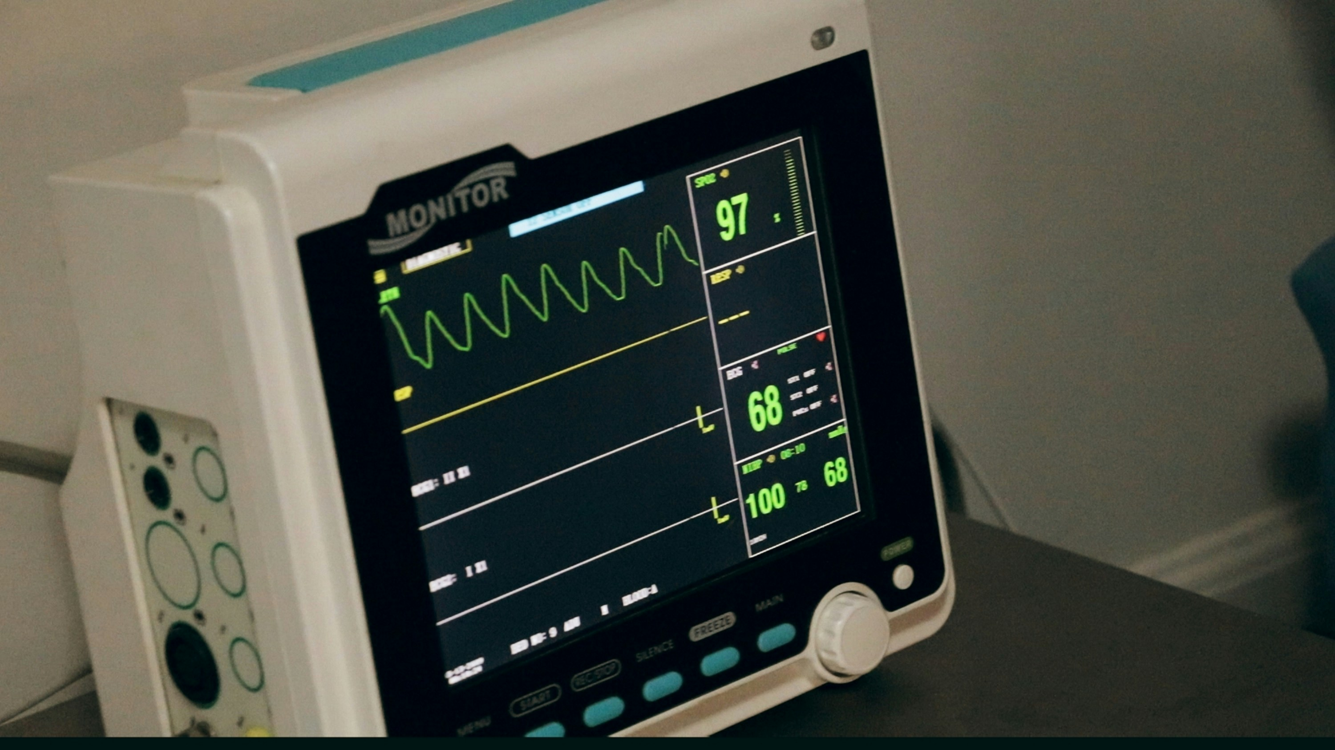
Mortality Prediction in ICU Patients
Team: Quantum-Six

Slide 2
Introduction
Overview
Project Overview
Mortality rates in ICUs are usually high (overall 35.9%); early identification of high-risk patients is critical for proper treatment and better survival outcomes
Predict patient mortality using the MIMIC-III dataset, applying data science and machine learning techniques.
Develop end-to-end ML pipeline with a web interface for clinicians to make data-driven decisions
Quantum-Six • ICU Mortality Prediction
2
Notes:
[Sources] - https://ohiostate.elsevierpure.com/en/publications/a-new-simplified-acute-physiology-score-saps-ii-based-on-a-europe/ (SAPS II reference) - https://jamanetwork.com/journals/JAMA/articlepdf/409377/jama_270_20_037.pdf (MPM II reference) - https://link.springer.com/article/10.1007/BF01720917 (discussion of limitations for individual prediction) [/Sources]
Melaku, Ermiyas Endewunet et al. “Determinants of Mortality of Patients Admitted to the Intensive Care Unit at Debre Berhan Comprehensive Specialized Hospital: A Retrospective Cohort Study.” Patient related outcome measures vol. 15 61-70. 22 Feb. 2024, doi:10.2147/PROM.S450502

Slide 3
Clinical Need
Motivation
Why mortality prediction in the ICU?
Clinical challenge
Limitations of traditional scores
ICU teams need accurate predictions to prioritize care and allocate resources effectively
Patient trajectories are nonlinear and ICU patient's conditions change rapidly, with fluctuating lab results, vitals, and organ failure markers
Decisions must be transparent — clinicians need why a prediction is made not just what, to ensure trust and proper action
Scores such as SAPS II and MPM II rely on fixed formulas, potentially leading to underperformance in personalized care
Limited temporal window (first 24 hours) and may not capture complex interactions. Inadequate ability to capture complex Interactions
ML models with larger, rich datasets offer more personalized, data-driven predictions over extended time periods
Quantum-Six • ICU Mortality Prediction
3
Notes:
[Sources]
https://doi.org/10.1016/j.ijnurstu.2017.09.003. - https://ohiostate.elsevierpure.com/en/publications/a-new-simplified-acute-physiology-score-saps-ii-based-on-a-europe/ (SAPS II reference) https://jamanetwork.com/journals/JAMA/articlepdf/409377/jama_270_20_037.pdf (MPM II reference)
https://link.springer.com/article/10.1007/BF01720917 (discussion of limitations for individual prediction) https://doi.org/10.1016/j.ijnurstu.2017.09.003

Slide 4
What we built
Project scope
Project objectives
Prediction
Interpretability
Deployment
Train separate models for
• In-hospital mortality
• 90-day mortality
• 180-day mortality
Use early ICU data to generate a probability and risk tier.
Use SHAP to explain individual predictions.
Provide clinically interpretable “risk drivers” (lactate, GCS).
Supporting Trust, and Clinical Review
Deliver a Django web app for clinicians.
Simulate real hospital data flows using JSON time-stamped measurements.
Offering predictions and show a risk-sorted patient overview.
Quantum-Six • ICU Mortality Prediction
4

Slide 5
Users and Beneficiaries
Target Users and Benefits in ICU Mortality Prediction
Primary users
Secondary users
Beneficiaries
ICU clinicians (doctors & nurses)
Rapid response / ICU outreach teams
Hospital management & ICU operations
Clinical researchers & data scientists
Patients - timely and targeted treatment
Hospitals - Cost optimization and better resource management; prioritization; operational efficiency, etc
Quantum-Six • ICU Mortality Prediction
5

Slide 6
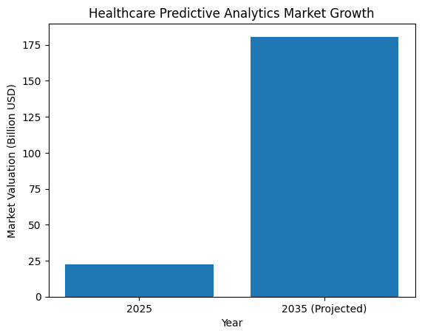
Business Case
Impact
Business value & deployment potential
Why hospitals care
Global Healthcare Predictive Analytics
ICU care ≈ 13% of hospital costs (SCCM)
ICU day ≈ $3k–$4k/day after day 3
How early risk prediction supports
Shorter ICU stay
Better triage & staffing
SOURCE: Precedence Research
Quantum-Six • ICU Mortality Prediction
6
Notes:
SCCM, https://sccm.org/communications/critical-care-statistics
Strategies of Predictive Schemes and Clinical Diagnosis for Prognosis Using MIMIC-III: A Systematic Review - DOI:
10.3390/healthcare11050710
Costs of Critical Care Medicine 10.1016/j.ccc.2011.10.003
Dasta, Joseph F et al. “Daily cost of an intensive care unit day: the contribution of mechanical ventilation.” Critical care medicine vol. 33,6 (2005): 1266-71. doi:10.1097/01.ccm.0000164543.14619.00

Slide 7
Dataset & access
MIMIC-III: ICU clinical database
Key properties
Modeling task
• De-identified ICU records from a large tertiary care center
• Includes vitals, labs, medications, procedures, diagnoses, and outcomes
• Access requires PhysioNet credentialing + data use agreement
• Outcomes modeled in this project: in-hospital, 90-day, 180-day mortality
ICU admission
ICU data collection (First 48h)
Feature aggregation, ML Model
Mortality probability
Quantum-Six • ICU Mortality Prediction
7
Notes:
[Sources] - https://physionet.org/content/mimiciii/1.4/ (MIMIC-III access + description) - https://europepmc.org/articles/PMC4878278 (MIMIC-III paper) [/Sources]

Slide 8
Methodology
End-to-end pipeline
Methodology framework
Data
extraction
Cohort
selection
Pre-
processing
Feature
engineering
Model
training
Web
deployment
CSV
from MIMIC
adult ICU
admissions
missingness
& scaling
aggregate
vitals/labs
LR vs
XGBoost
Django +
SHAP
Key design choices
Separate models per prediction horizon (in-hospital / 90-day / 180-day) to reflect different clinical questions.
Robust preprocessing: missing value handling, normalization, and consistent feature extraction between training and inference.
Evaluation emphasizes discrimination (ROC-AUC) and clinical usability (risk tiers + explanations).
Quantum-Six • ICU Mortality Prediction
8

Slide 9
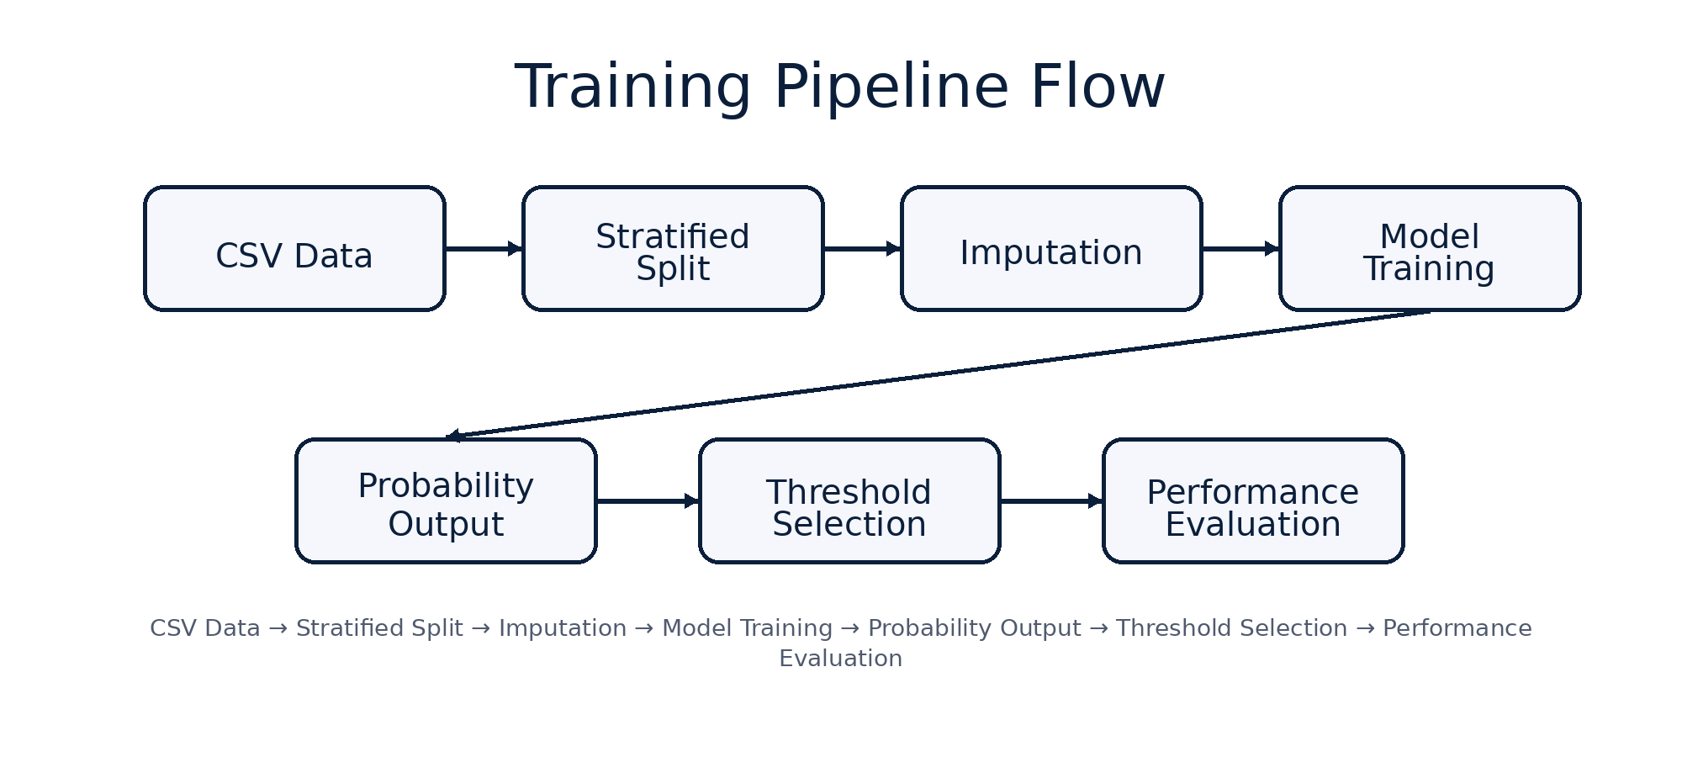
Modeling approach and Training Pipeline
Models
Modeling Strategy
Training Pipeline
Stratified Train/Validation Split (80/20)
Median Imputation for Missing Values
Class Imbalance handled using class_weight
Probability-based Risk Prediction
Evaluation: AUROC, Precision-Recall, Confusion Matrix
CSV Data → Stratified Split → Imputation → Model Training → Probability Output → Threshold Selection → Performance Evaluation
Quantum-Six • ICU Mortality Prediction
9
Notes:
[Sources] - https://arxiv.org/abs/1603.02754 (XGBoost) [/Sources]

Slide 10
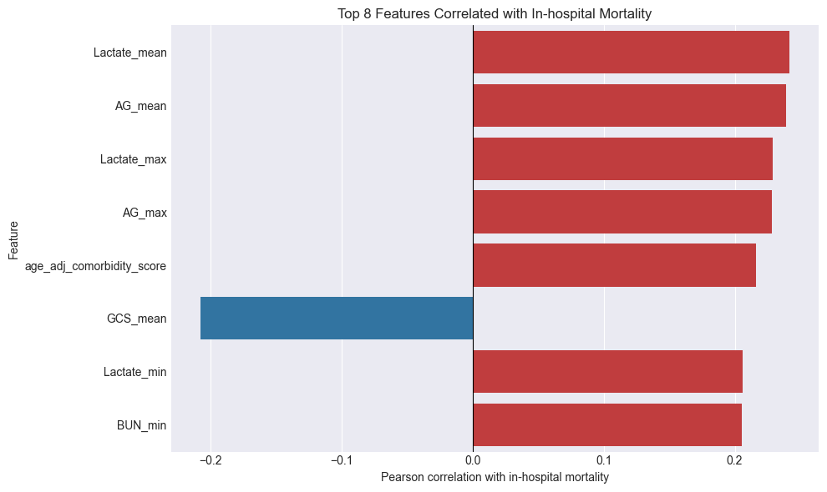
Feature Extraction
Correlation coefficient value with target variable
Top Positive Correlations
Lactate_mean and AG_mean have the highest positive correlations
Negative Correlations
GCS_mean and GCS_max exhibit negative correlations; higher GCS scores (neurological status) are associated with lower mortality risk
Lactate and Anion Gap (AG) are the most significant positive predictors of hospital mortality
Quantum-Six • ICU Mortality Prediction
10
Notes:
[Sources] - https://arxiv.org/abs/1705.07874 (SHAP) [/Sources]

Slide 11
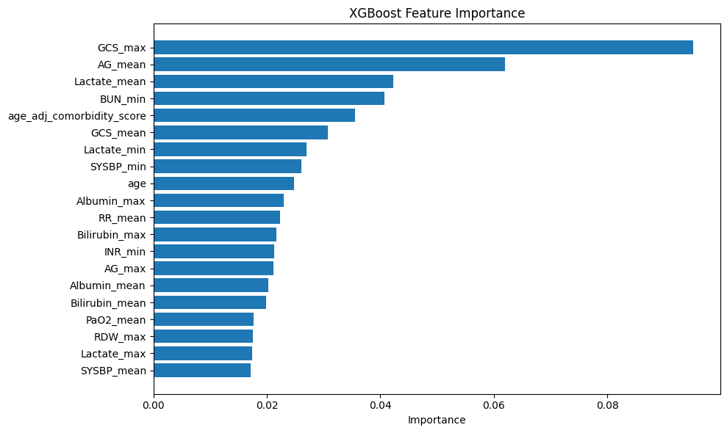
Feature Extraction
Top Features Influencing In-Hospital Mortality Prediction
Feature relevance (example: in-hospital)
Key Features for In-Hospital Mortality Prediction
Lactate levels, Anion Gap (AG), and BUN (Blood Urea Nitrogen) are the strongest indicators
Physiological variables like lactate and AG, along with neurological assessments (GCS), are critical for mortality risk prediction
Quantum-Six • ICU Mortality Prediction
11
Notes:
[Sources] - https://arxiv.org/abs/1705.07874 (SHAP) [/Sources]

Slide 12
Key predictors and Clinical insight
What the model learned (aligned with ICU physiology)
Metabolic instability
Multi-organ dysfunction
Neurological status
Lactate and anion gap are among the strongest risk signals.
Suggests hypoperfusion, shock, or severe metabolic derangements.
Kidney markers: BUN (urea), creatinine-related features.
Liver markers: bilirubin and liver-related enzymes.
Combines organ systems beyond basic vital signs.
GCS features show a strong negative association with mortality.
Lower consciousness levels correspond to higher risk, consistent with clinical practice.
Quantum-Six • ICU Mortality Prediction
12

Slide 13
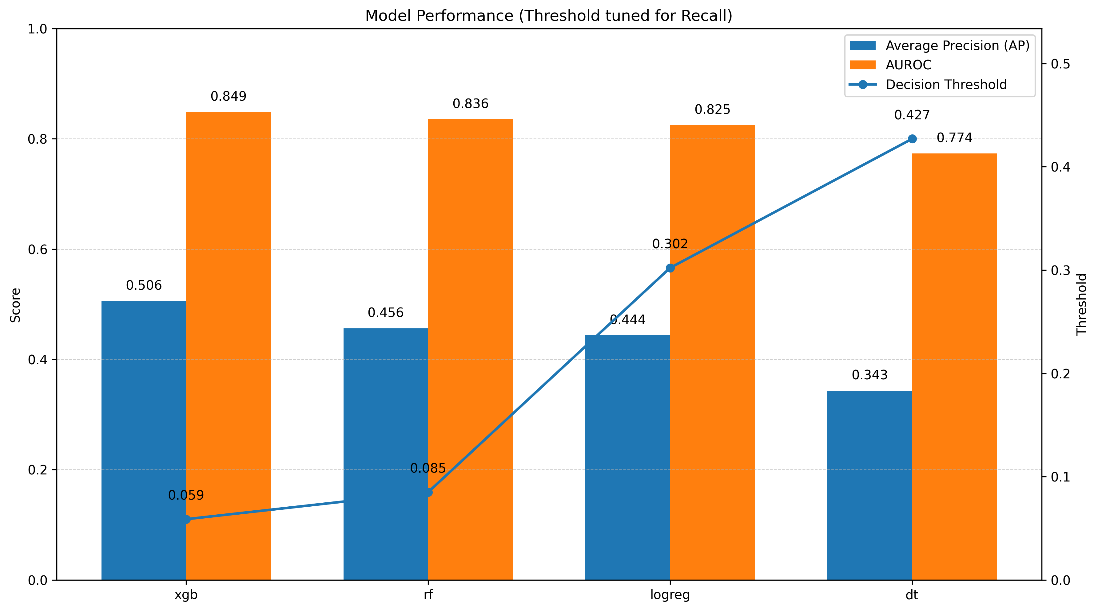
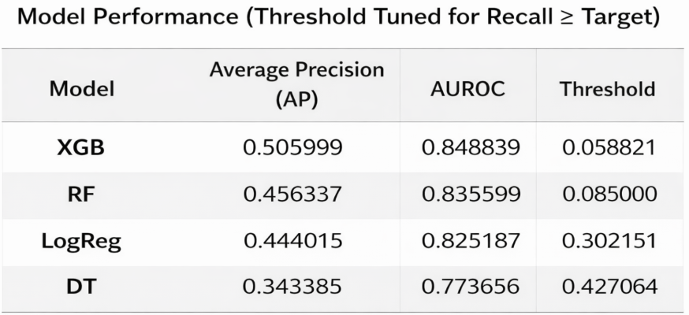
Performance
In-hospital mortality: discrimination performance
Quantum-Six • ICU Mortality Prediction
13

Slide 14
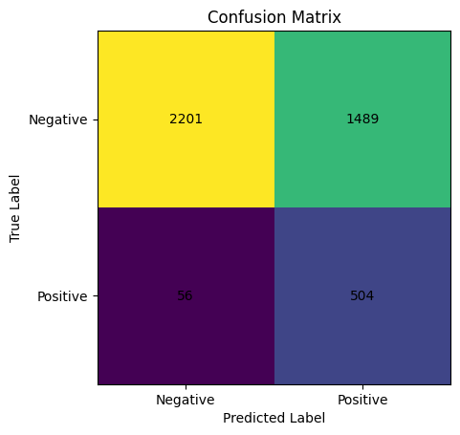
Modeling approach and Training Pipeline
Confusion Matrix Summary (XGBoost)
True Negatives (TN): 2201
False Positives (FP): 1489
False Negatives (FN): 56
True Positives (TP): 504
Confusion Matrix (Tuned Threshold)
Quantum-Six • ICU Mortality Prediction
14
Notes:
[Sources] - https://arxiv.org/abs/1603.02754 (XGBoost) [/Sources]

Slide 15
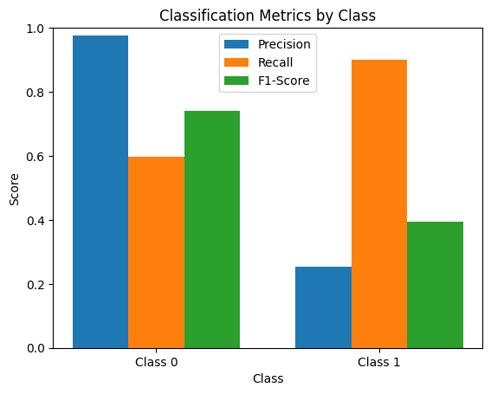
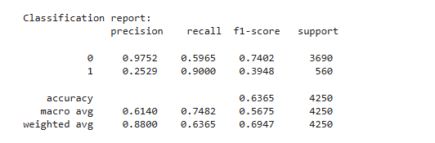
Modeling approach and Training Pipeline
Performance Metrics (XGBoost)
Recall (Mortality): 0.9
Precision (Mortality): 0.2529
F1-score: 0.3948
Accuracy: 0.6365
Survived
Died
Quantum-Six • ICU Mortality Prediction
15
Notes:
[Sources] - https://arxiv.org/abs/1603.02754 (XGBoost) [/Sources]

Slide 16
System architecture
Deployment
Architecture (Django + ML inference + SHAP)
Front-end
Backend (Django)
ML services
HTML/CSS/JS UI
Patient form / JSON upload
Risk-tier display
Routing + validation
Feature extraction
Prediction storage
Pretrained model
SHAP explanations
Model metadata
Input UI
JSON parser
Model.pkl
Single-patient view
Eligibility check
SHAP explainer
Quantum-Six • ICU Mortality Prediction
16

Slide 17
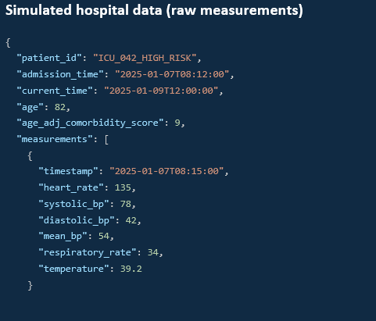
Web app concept
Deployment
Clinical web app workflow
Simulated hospital data (raw measurements)
Backend workflow
1) JSON ingestion
Parse JSON → pandas DataFrame (time-stamped measures).
2) Eligibility check
Verify ≥ 48 hours of data; otherwise show “available in …”.
3) Feature extraction
Compute aggregates (mean/max/min) using training logic.
4) Model inference
Run pretrained model → mortality probability + risk tier.
5) Explanation
SHAP highlights feature contributions for the prediction.
6) Prioritization view
Store predictions; show a risk-sorted patient list.
Quantum-Six • ICU Mortality Prediction
17

Slide 18
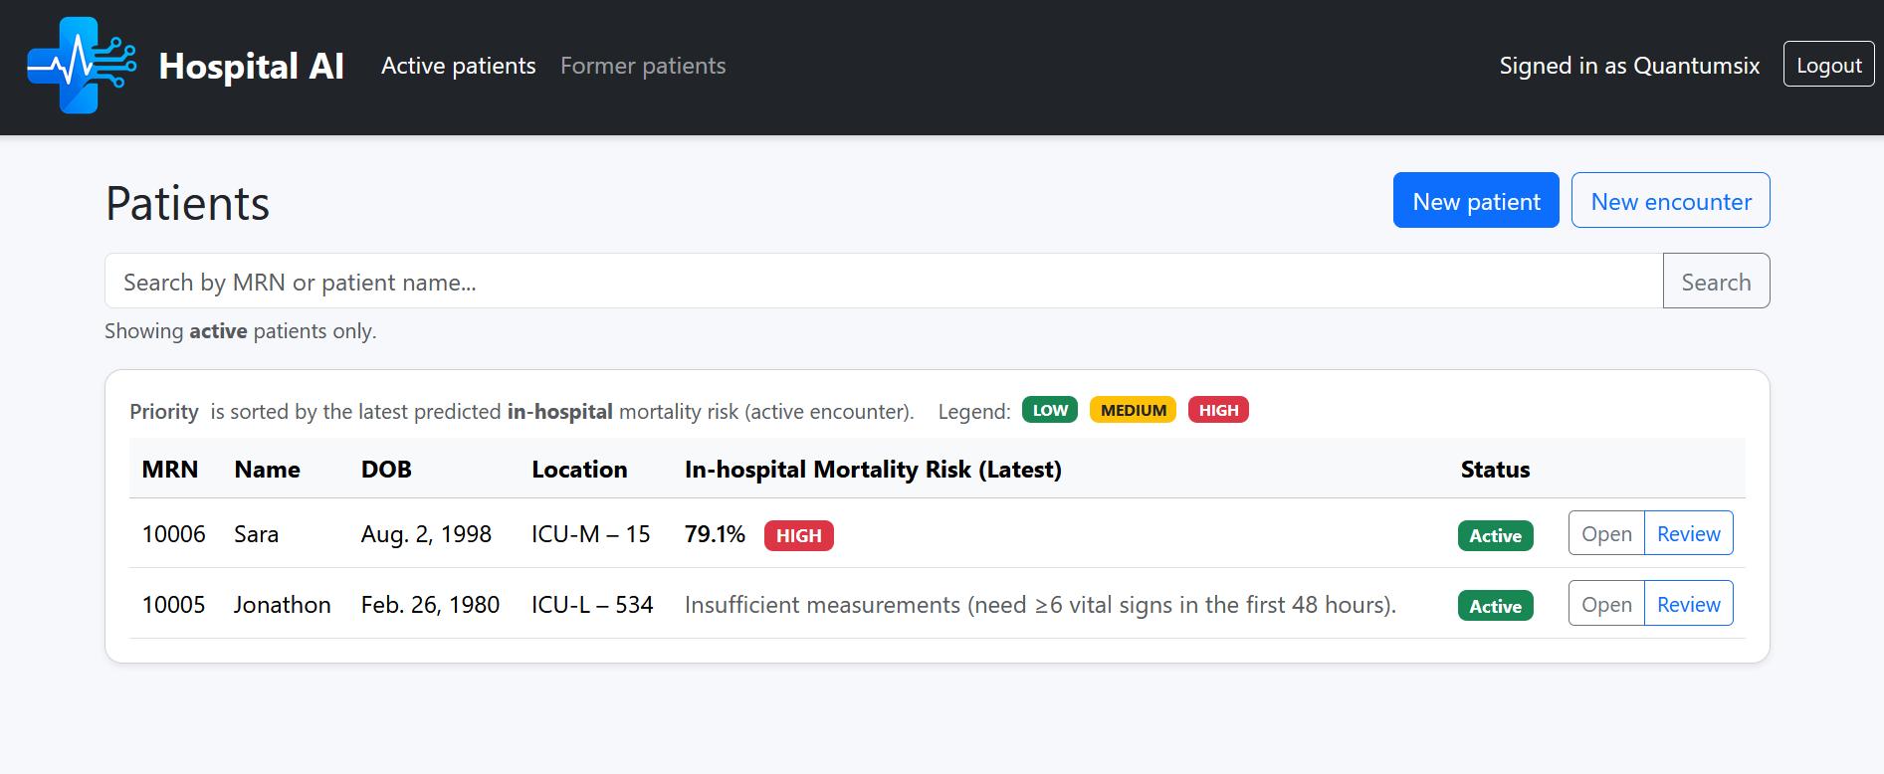
Web interface
Demo
Web interface: prediction + explanation
Input feat
(sidebar)
SHAP plot
(feature contributions)
Quantum-Six • ICU Mortality Prediction
18

Slide 19
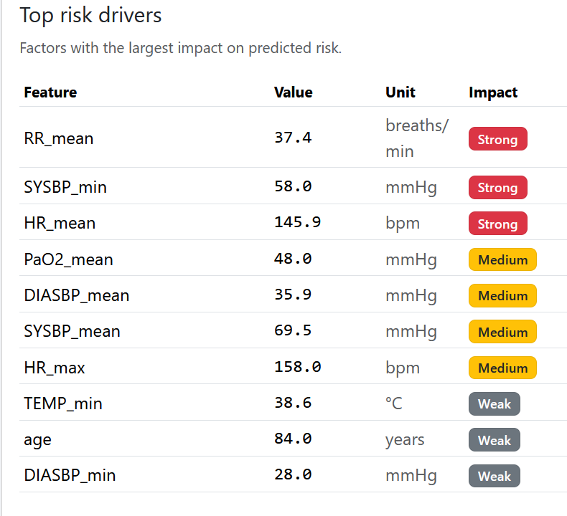
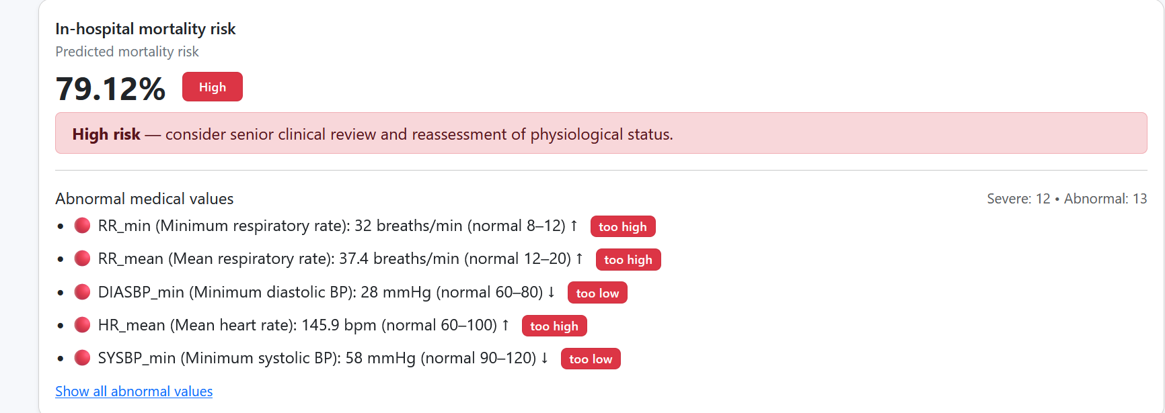
Web interface
Demo
Risk assessment
Input feat
(sidebar)
SHAP plot
(feature contributions)
Quantum-Six • ICU Mortality Prediction
19

Slide 20
Impact
Potential impact in clinical workflow
Enhanced risk stratification
Optimized triage & resources
Identify high-risk patients earlier and prioritize closer monitoring and rapid response.
Support staffing decisions, ICU resource allocation, and escalation planning.
Transparency for adoption
Deployable prototype
SHAP-based drivers help clinicians verify if the model is “looking at the right signals”.
Web Based Application
Quantum-Six • ICU Mortality Prediction
20
Notes:
Hur, Sujeong et al. “Comparison of SHAP and clinician friendly explanations reveals effects on clinical decision behaviour.” NPJ digital medicine vol. 8,1 578. 26 Sep. 2025, doi:10.1038/s41746-025-01958-8
https://doi.org/10.2196/44065.

Slide 21
Limitations
Limitations
Technical limitations
Clinical considerations
Single hospital data
Changes across hospitals and over time
Only first 48 hours data used
Class Imbalance
Support tool, not a decision maker
Needs real-world testing
Doctors must observe result to take final decision
Predictions can influence treatment
Quantum-Six • ICU Mortality Prediction
21
Notes:
Balch, J.A., Brandberg, J.G., Andris, R.T. et al. Equipping mathematical models for hospital dynamics using information theory. npj Digit. Med. 8, 652 (2025). https://doi.org/10.1038/s41746-025-02013-2
- https://physionet.org/content/mimiciii/1.4/ (MIMIC-III access + context for dataset limitations) [/Sources]

Slide 22
Future work
Future work
Prospective & external validation
External validation: Test the model on data from other hospitals
Dynamic risk prediction: Update predictions over time instead of using only the first 48h
Prospective evaluation: Test the model in a real clinical workflow.
Improve interpretability: Clearer explanations for clinicians.
Model refinement: Feature selection, calibration, and robustness improvements.
Quantum-Six • ICU Mortality Prediction
22

Slide 23
Thank you
Questions & Discussion
- - - - - - - - - - - - - - - - - - - - -
Notes:
[Sources] - https://physionet.org/content/mimiciii/1.4/ (dataset) - https://arxiv.org/abs/1603.02754 (XGBoost) - https://arxiv.org/abs/1705.07874 (SHAP) [/Sources]

Slide 24
Sources:
https://ohiostate.elsevierpure.com/en/publications/a-new-simplified-acute-physiology-score-saps-ii-based-on-a-europe/ (SAPS II reference) https://jamanetwork.com/journals/JAMA/articlepdf/409377/jama_270_20_037.pdf (MPM II reference) https://link.springer.com/article/10.1007/BF01720917 (discussion of limitations for individual prediction) Melaku, Ermiyas Endewunet et al. “Determinants of Mortality of Patients Admitted to the Intensive Care Unit at Debre Berhan Comprehensive Specialized Hospital: A Retrospective Cohort Study.” Patient related outcome measures vol. 15 61-70. 22 Feb. 2024, doi:10.2147/PROM.S450502 https://jamanetwork.com/journals/JAMA/articlepdf/409377/jama_270_20_037.pdf (MPM II reference)
https://link.springer.com/article/10.1007/BF01720917 (discussion of limitations for individual prediction) https://doi.org/10.1016/j.ijnurstu.2017.09.003
SCCM, https://sccm.org/communications/critical-care-statistics; Strategies of Predictive Schemes and Clinical Diagnosis for Prognosis Using MIMIC-III: A Systematic Review - DOI: 10.3390/healthcare11050710
Costs of Critical Care Medicine 10.1016/j.ccc.2011.10.003
Dasta, Joseph F et al. “Daily cost of an intensive care unit day: the contribution of mechanical ventilation.” Critical care medicine vol. 33,6 (2005): 1266-71. doi:10.1097/01.ccm.0000164543.14619.00
https://physionet.org/content/mimiciii/1.4/ (MIMIC-III access + description)
https://europepmc.org/articles/PMC4878278 (MIMIC-III paper)
https://arxiv.org/abs/1603.02754 (XGBoost)
https://arxiv.org/abs/1705.07874 (SHAP)
Hur, Sujeong et al. “Comparison of SHAP and clinician friendly explanations reveals effects on clinical decision behaviour.” NPJ digital medicine vol. 8,1 578. 26 Sep. 2025, doi:10.1038/s41746-025-01958-8
https://doi.org/10.2196/44065.
Balch, J.A., Brandberg, J.G., Andris, R.T. et al. Equipping mathematical models for hospital dynamics using information theory. npj Digit. Med. 8, 652 (2025). https://doi.org/10.1038/s41746-025-02013-2
https://physionet.org/content/mimiciii/1.4/ (MIMIC-III access + context for dataset limitations)
Quantum-Six • ICU Mortality Prediction
24

